Slide 1
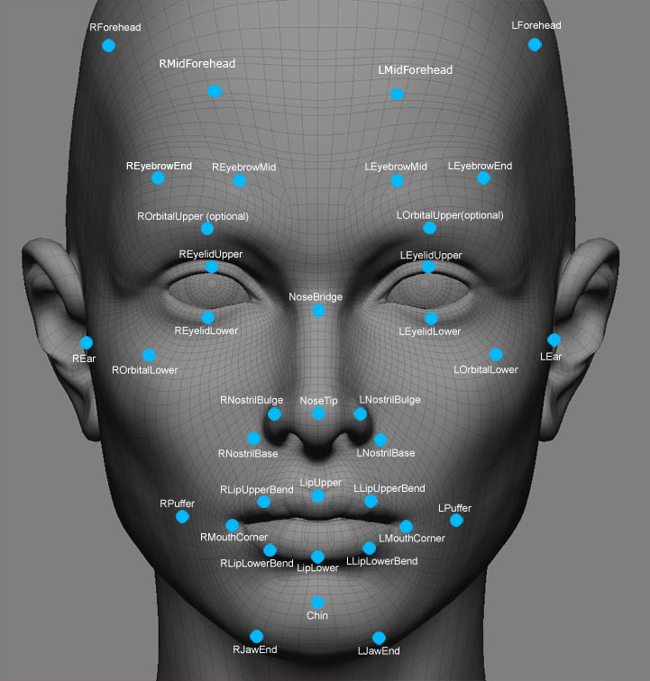

Security Guard
Recognition and
Location Tracking
Progress Evaluation

Slide 2
Table of Contents
Group Introduction
Current Status of Project
01
06
Project Description
Evidence of Progress
02
07
FYP Scope
Data Flow Diagram for Face Recognition
03
08
Project Plan
Challenges and Problems Encountered
04
09
Project Tools & Hardware
Useful Resources
05
10
Security Guard Recognition and Location Tracking

Slide 3
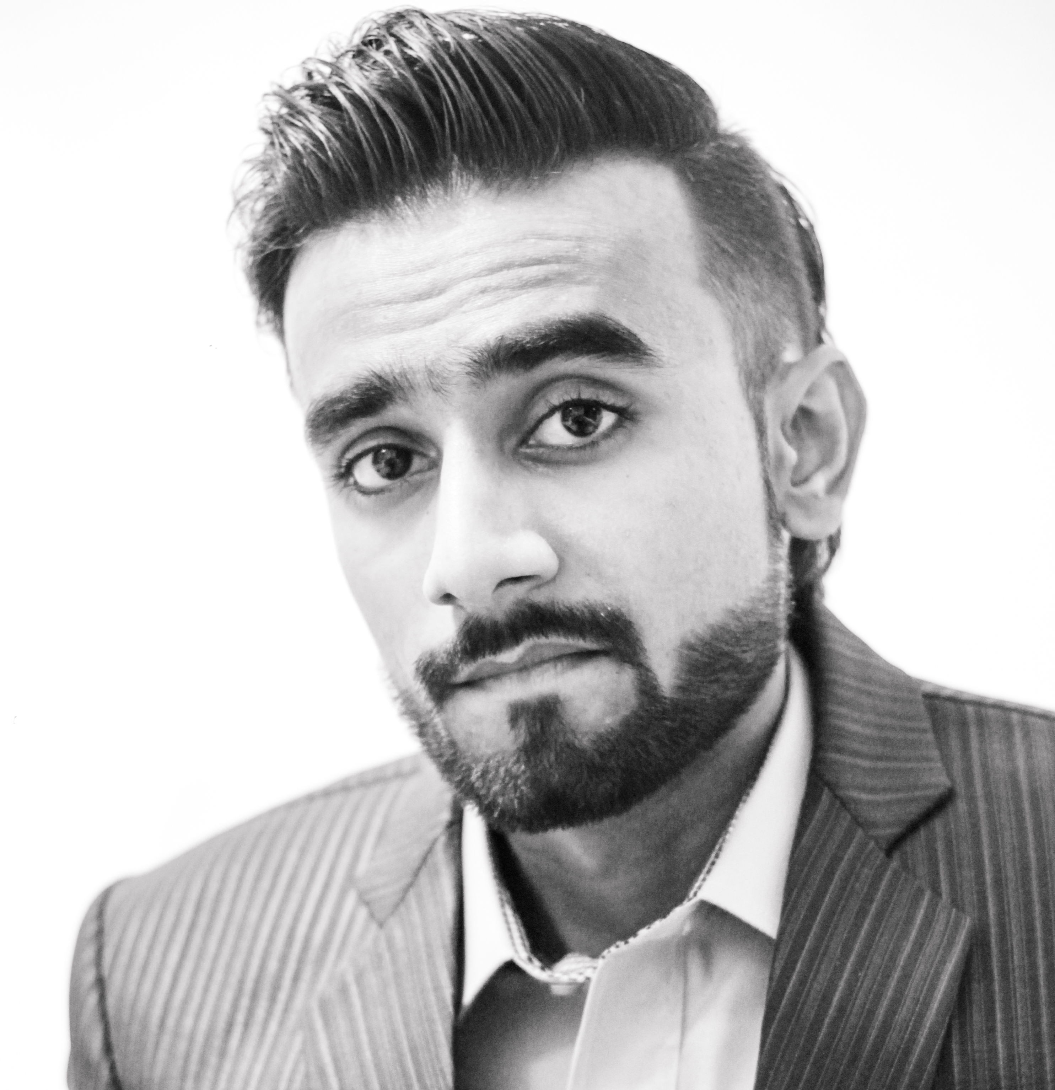
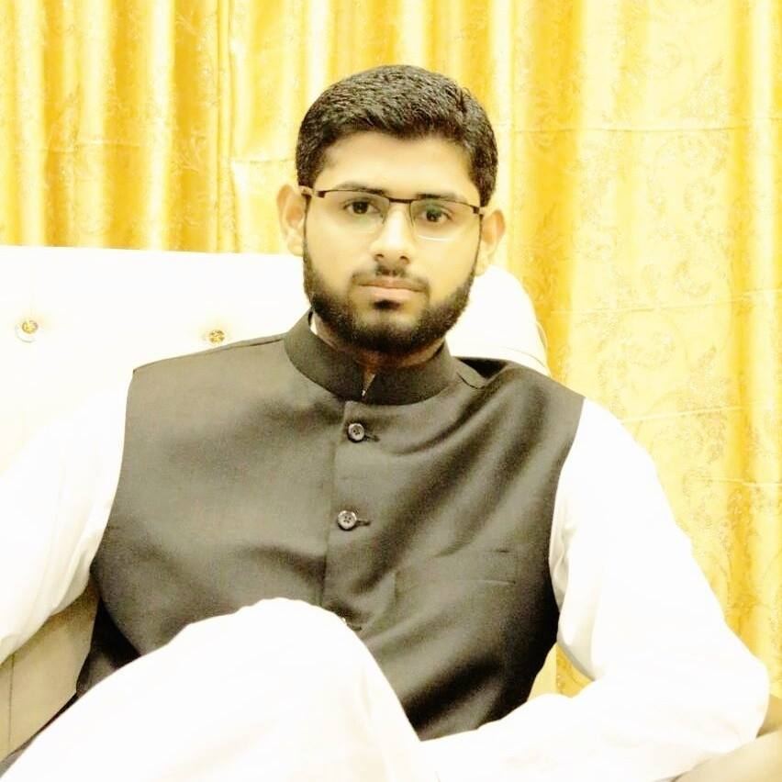
Group Introduction
01
Shahzaib Khan
BSCS/F13/0145
M. Bilal Saeed
BSCS/F13/0149
Security Guard Recognition and Location Tracking

Slide 4
Group Introduction (Cont’d)
01

Sir Iqbal Uddin Khan (Asst. Prof.)
Supervisor

Ma’am Saboohi Mahmood (Asst. Prof.)
Co-Supervisor

We have a good communication between us.

Relevant Expertise & Experience.
Security Guard Recognition and Location Tracking

Slide 5

Project Description
02
 Earlier there was a problem that security guard was not available during duty hours and in result we observe the attack on different universities, Moreover a person find him here-there where he was gone and it is also time wasting.
 FYP Objectives
 Improve and enhance Security System.
 Track location and keep record of Security Guard.
Security Guard Recognition and Location Tracking

Slide 6
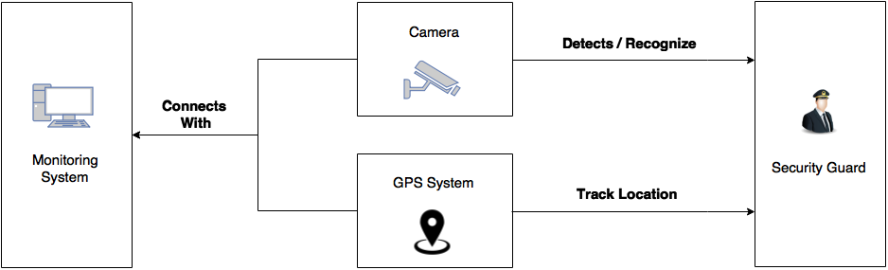
FYP Scope
03
 The main objective of this project is to design and implement a system that will capture images with live video through surveillance camera, using JavaCV it will recognize security guard face and if he will exits/move from the limits of surveillance camera then it will indicate or displayed a message.
 For GPS Tracking system we are using “Traccar” Software. It reports location using Tracking Chip and alternatively Smart Phone can also be use.
Security Guard Recognition and Location Tracking

Slide 7
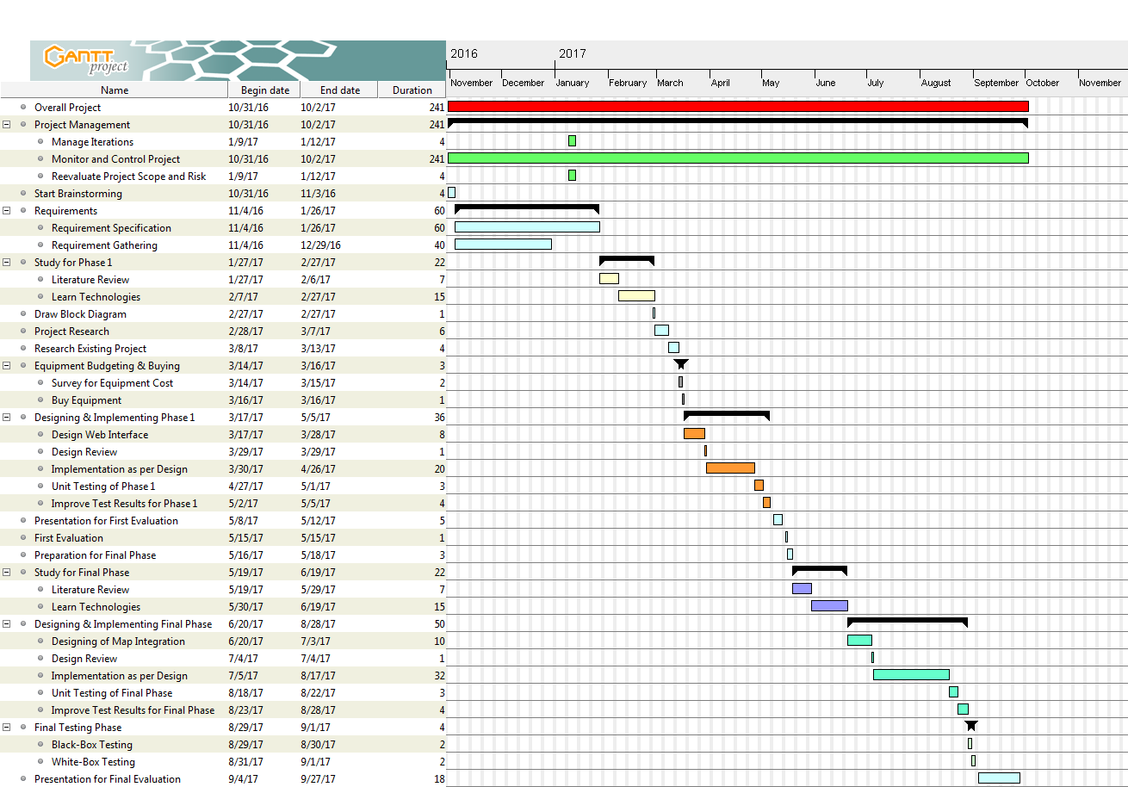
Project Plan
04
 Project Plan can be seen in this Gantt Chart.
Security Guard Recognition and Location Tracking
Note: Dates are Tentative.

Slide 8
Project Plan (Cont’d)
04
 Approximate work (Face Recognition) completion till Progress Evaluation (Before Mid-Term of 8th Semester).
 Approximate Date for Final Report (Date: 27-09-2017). – (Complete Project)
Security Guard Recognition and Location Tracking
Note: Dates are Tentative.

Slide 9

Project Tools & Hardware
05
U Tools Required
 JavaCV – It is a Library of Programming Functions.
 XAMPP - open source cross-platform local web server.
 Traccar – GPS Tracking Software.
P Hardware Requirements
 Surveillance Camera.
 Mini GPS A9 Tracking Device.
 Desktop / Laptop with Internet Connectivity.
Note: Tools and Hardware are Tentative.
Security Guard Recognition and Location Tracking

Slide 10
Current Status of Project
06
 The project is divided into two Phases:
Phase 1: Face Recognition.
Phase 2 (Final Phase): Location Tracking.
 Phase 1 is almost completed.
E
Start
o
[
#
Jan 14, 2017
Oct 31, 2016
Create Application
Learn OpenCV with Java
Mar 02, 2017
Nov 09, 2016
Face Recognition
Research on Existing Project
Security Guard Recognition and Location Tracking

Slide 11
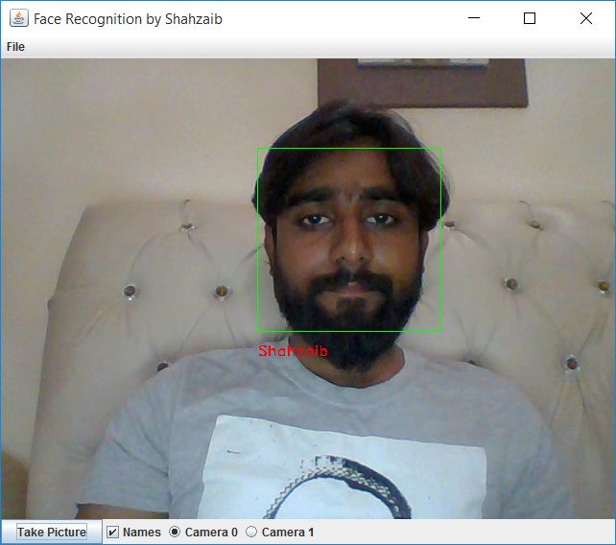
Evidence of Progress
07
 Face Recognition Application.
Security Guard Recognition and Location Tracking

Slide 12
Data Flow Diagram for
Face Recognition
08
Security Guard Recognition and Location Tracking

Slide 13
Challenges and Problems Encountered
09
 The first challenging task was setting up an environment of OpenCV in Java.
 Second challenging task was Face Detection using HaarCascade (Algorithm for Face Detection).
Security Guard Recognition and Location Tracking

Slide 14
Useful Resources
10
 GitHub. “OpenCVFaceRecognizer.java” Last Access: 7:55:00 PM (PKT), 15/03/2017.
https://github.com/bytedeco/javacv/blob/master/samples/OpenCVFaceRecognizer.java
 OpenCV Java Tutorials. “Face Detection and Tracking” Last Access: 7:59:38 PM (PKT), 15/03/2017.
http://opencv-java-tutorials.readthedocs.io/en/latest/06-face-detection-and-tracking.html
 Petter Chr. Bjelland. “Doing face recognition with JavaCV” Last Access: 8:03:41 PM (PKT), 15/03/2017.
https://pcbje.github.io/misc/2012/12/01/doing-face-recognition-with-javacv.html
 Baggio, Daniel Lelis. ”OpenCV 3.0 Computer Vision with Java”. 2015.
Security Guard Recognition and Location Tracking

Slide 15

Security Guard Recognition and Location Tracking

